Slide 1
European Network for Pilot Production Facilities and Innovation Hubs
nanoSAFE
Grenoble, 7th November 2018

Slide 2
Objectives
Provide a sustainable interactive and dynamic participatory digital market place (match-making tool) allowing pilot lines to become connected with users (technology up-takers, policy makers, investors and other actors) in the ecosystem, along industrial value chains .
Provide a common digital market place connecting various forms of users with each others. (eg. technology providers with buyers).
Facilitate Europe-wide access, to specialised facilities and expertise.
Provide instant access to high-quality, reliable, and updated information related with access to testing and product developments facilities, expertise and related complementary support structures.
Provide companies (startups, SMEs and large companies) with assurance about the quality of the services being provided and access conditions.

Slide 3
Platform Users
Users:
End-users (SME–LE)
Pilot owners
Innovation Hubs with pilot lines
Innovation Hubs without pilot lines
Service providers
Safety, modelling, characterization clusters/networks
Technology translators/Tech. Transfer offices
EEN members
NCPs
Investors
Regional/national authorities
Outputs
Match providers with possible up-takers.
Bring together actors along value chains.
Promote the upscaling, demonstration, characterisation and modelling of advanced materials (nanomaterials).
Assist new users in developing and applying new NMBP based developments/products.
Develop novel products or services based on NMBP pilot lines.
Ensure that companies get access to the latest expertise and technologies.
Show capacities (geo-based) enabling understanding of e.g. bottlenecks.
High-level filtering by key-words to give users geographical/technical/product/market area they are interested in
The digital marketplace offers the google-like functionality to find information without the need to know up-front the classifications that are used to structure input data in the data-bases.
Hence, it is a true digital platform that effectively will deliver wanted market information to a market user.

Slide 4
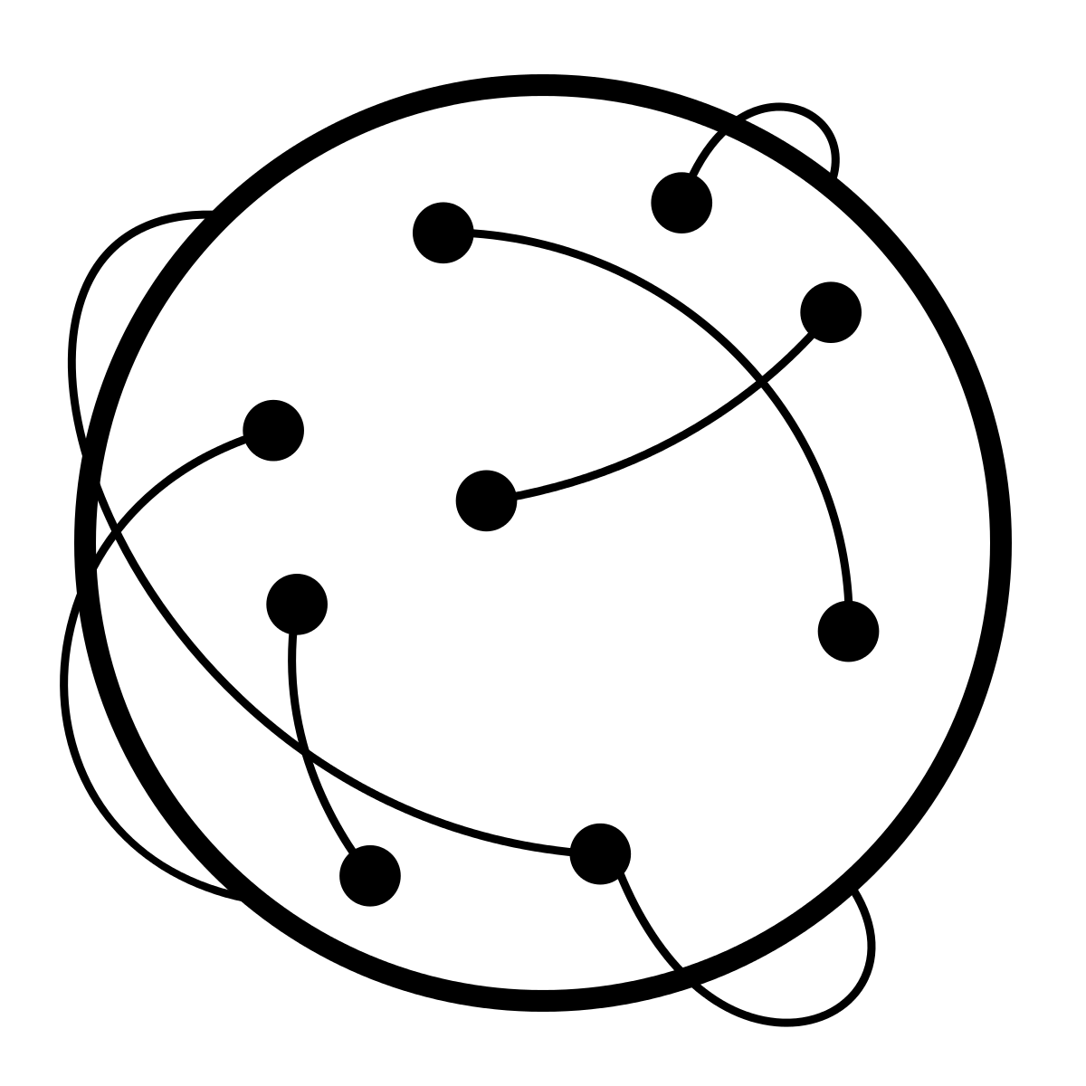
EPPN Functionalities
N
N
Mapping Profiles Offer Matching Transaction Filtering Finding Visualisation
Presentation
layer
BIG PICTURE
Business
layer
Mapping Communicating Sharing Networking
Database
layer
Notes:
A single entry point connecting pilot facilities, expertise, infrastructures, interfacial organisations and investors.
Effective Up-to-date data
Match making capability (tech sellers-buyers) along value chains.
Search a pilot plant profile (organization, country, target market, pilot input and output, ongoing projects, equipment, ...).
Access to active pilot network for choosing partners in future projects.
Possibility for mutual access to other networks with direct links to DIH & DG-Grow pages.
By liaising with other DBs testing upscaling, characterization and modelling is facilitated

Slide 5
Safety in Pilot Lines
Increasing push from the EC to address safety
Need for harmonised and clear approach for safety assessment
Necessity to address safety in pilot projects
However, no guidelines on the extent of safety
Minisurvey understand how pilot projects approache the safety assessment

Slide 6
Safety in Pilot Lines
Is safety addressed?
Are the materials in nanoscale (>100 nm)

Slide 7
Safety in Pilot Lines
Dedicated partner?
Exposure?

Slide 8
Safety in Pilot Lines
Release?
Toxicity?

Slide 9
Safety in Pilot Lines

Slide 10
Safety in Pilot Lines
Use of tools?
SbD?

Slide 11
Safety in Pilot Lines
Safe by Design
PPE
Selection of materials based on risk factor
Recommendations. E.g. closed system
Engineering of final product to mitigate release
Redesign of pilot line
Safety database for produced materials

Slide 12
Safety in Pilot Lines
Tools Used
Questionnairs
Ecetoc TRA
Modified environmental standard test systems
HAZOP
ISO Control banding
OECD harmonized tiered approach
Stoffenmanager nano
Decision trees

